Slide 1
PAPR Reduction for Layered Modulations

Slide 2
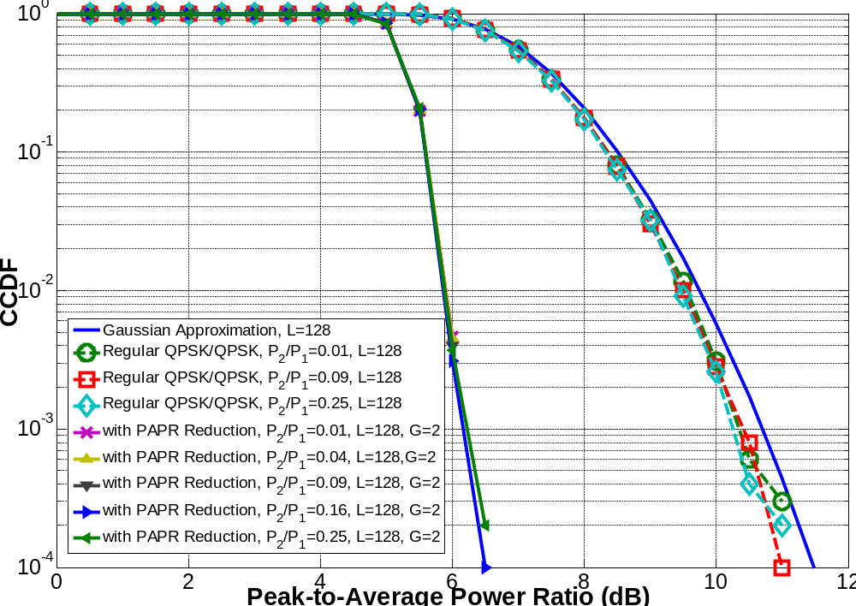

Slide 3
